Slide 1
Netflix Implementation in Neo4j Graph Database
MET CS779 Final Project
Duan Lin
May 1, 2021

Slide 2
Outline
Introduction and Setup
UI Preview
Main Tasks
Nodes and Relations
Java Integration
Code Implementation
Results Display
Future Works

Slide 3

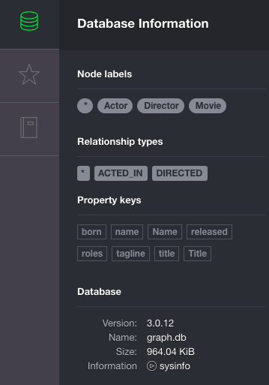
Introduction – Neo4j
Neo4j is the world’s leading graph database, and its architecture is designed for optimal management, storage and traversal of nodes and relationships.
Neo4j uses property graphs to represent data and the relationships that consists of vertices (circles) and edges (intersection lines).
Types of graphs:
Undirected graphs
Directed graphs
Graphs with labels
Property graphs
Use cases of Neo4j:
Fraud detection
Real-time recommendations and social networks
Master data systems

Slide 4
Introduction – Neo4j
Advantages:
Easy to represent connected data.
Faster to traversal of more connected data.
Represents semi-structured data very easily (JSON, XML)
Not require complex joins to retrieve related data
Drawbacks:
Limitation of supporting number of Nodes, Relationships and Properties from Neo4j 2.1.3 version.
Does not support sharding.

Slide 5
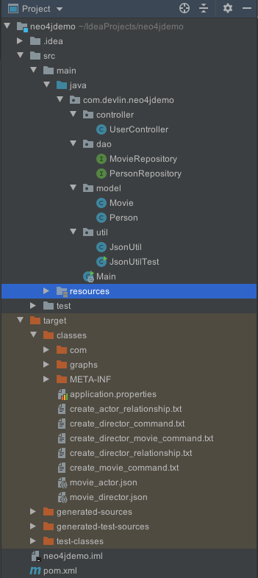
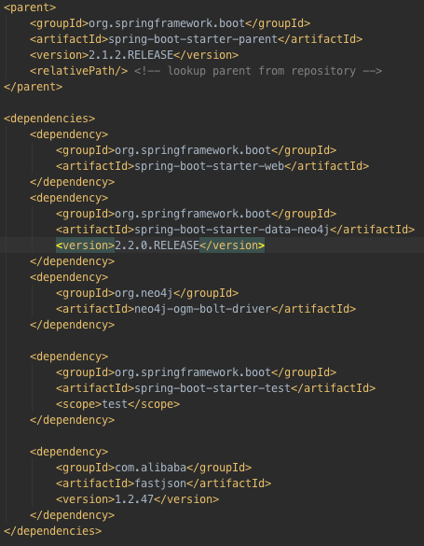
Introduction – Setup
1. Run Docker with Neo4j. I used “docker run --publish=7474:7474 --publish=7687:7687 neo4j:3.0” command to bring up Neo4j server.
2. Open the Neo4j browser URL. http://localhost:7474/browser
3. Create a Maven project, using Spring Boot to run the Java application, and design MVC (Model, View, Controller) structure to represent the “NodeEntity” and its relationships.
4. In pom.xml, I added dependencies including the default Spring Boot starters, Spring Data Neo4j, Bolt driver and Fastjson (used for convert JSON file into object array).
5. Create Main class to run the application, then all the setup works done.

Slide 6
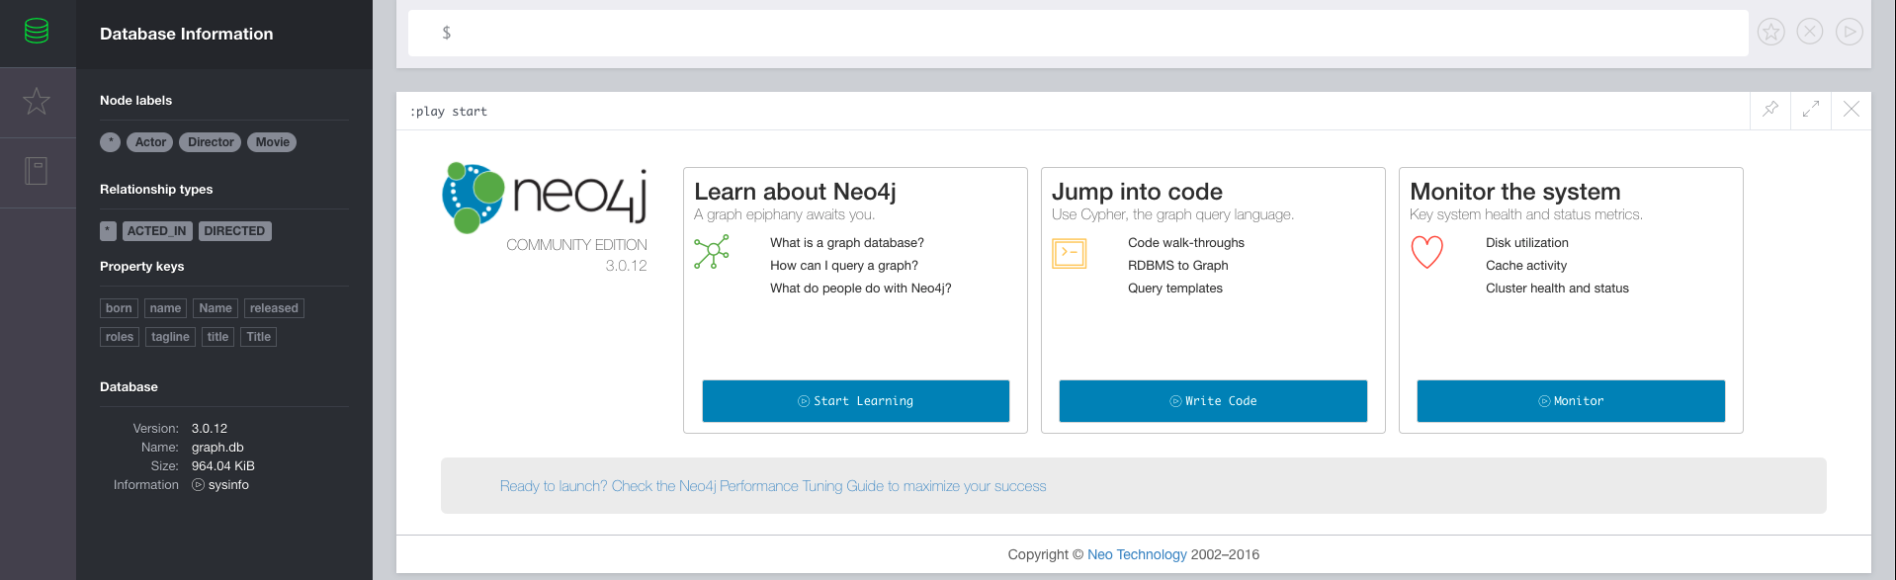
UI Preview
I

Slide 7
Main Tasks
Database source: Netflix database stored in MS SQL Server.
Entities: MoviePerson(PersonName, PersonRole), DVD(DVDTitle)
Issues:
How to process the raw query result in Java from SQL Server?
How to connect the person’s role relationships from themselves to different movies?
How to extract the “Node Entity” from exported files and create them in Neo4j, without duplication?
How to execute command (automatically) to build the networks?
Targets:
Write SQL query to get which movies are directed by those “directors”, and which movies are related to those “actors” / “actress”.
Export SQL query result into file, try to deconstruct each pair of “Person” and “Movie”, use OOD(object-oriented design) principle in Java class to build “Node Entity”.
Based on the Spring Data Neo4j, implement key methods.
Use Cypher Query Language (CQL) and write codes to execute “CREATE”, “MATCH” and “MERGE” commands to build the graph in Neo4j.
Write Java code to automatically output required commands using PrintStream/BufferedWriter.

Slide 8
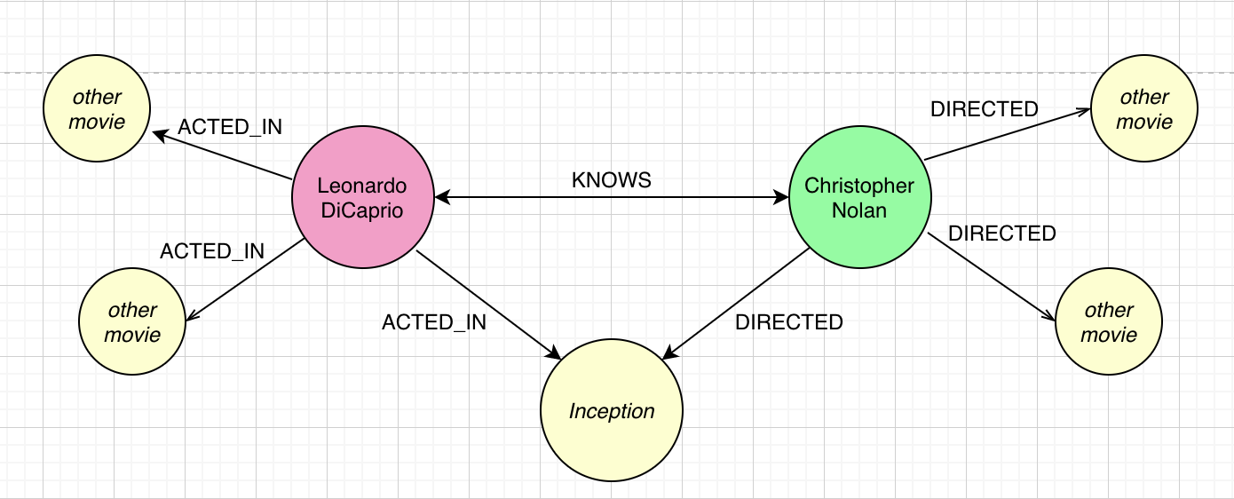
Nodes and Relations
A graph is made up of a set of vertices and a set of edges, and Neo4j structure is based on property graph model, consisting of nodes, which are the vertices, and any number of relationships, which are the edges/paths between these nodes.
Nodes and relationships can contain properties in Neo4j.Properties, sets of key-value pairs that describe the node or relationship.
In Netflix database, for example, each director has a property like “Director: {Name: ‘Christopher Nolan’}”, and each movie has a property like “Movie: {Title: ‘Inception’}”, each actor has a property like “Actor: {Name: ‘Leonardo DiCaprio’}”.
Since we have these nodes and properties, we can find several relationships. For example, Christopher Nolan directed the movie Inception, and Leonardo DiCaprio is one of the casts and he acted in the Inception.
Three main relationships
Acted in (Actors or Actresses)
Directed (Directors)
Knows (Actors->Directors, Actors->Actors, etc.)
The template we need to design:
MATCH/CREATE (a: Actor: {Name: xxx}),
(b: Director: {Name: xxx}), {m: Movie: {Title: xxx}}
MERGE (a)-[r:ACTED_IN]->(m)<-[r:DIRECTED]-(b)
MERGE (a)-[r:KNOWS]->(b)-[r:KNOWS]->(a)
……

Slide 9
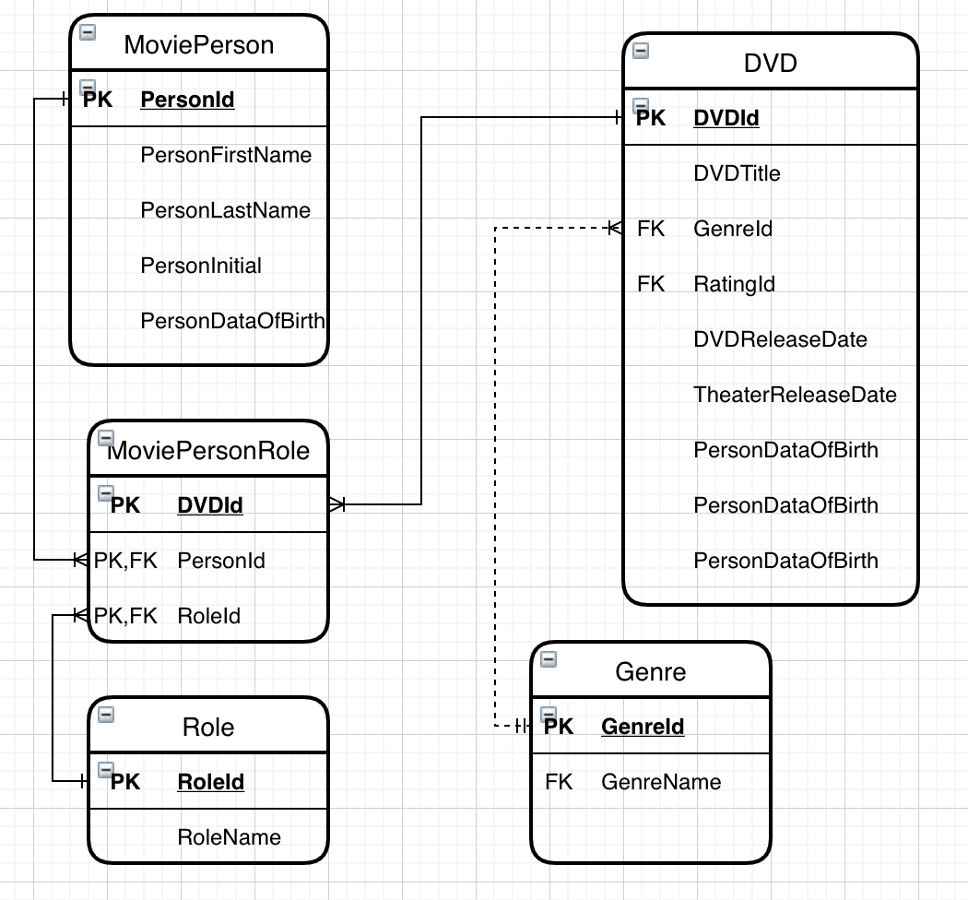
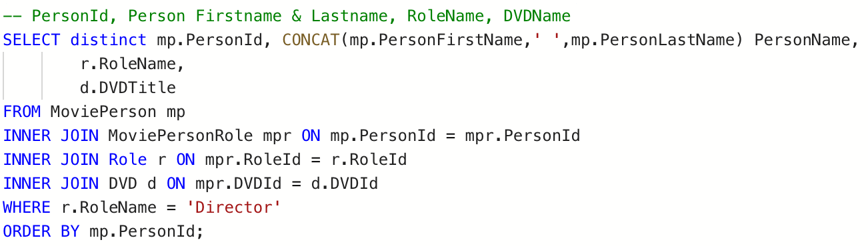
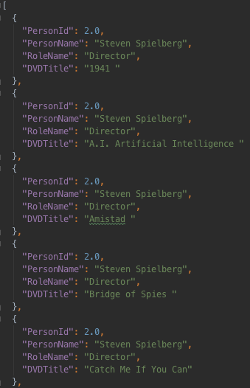
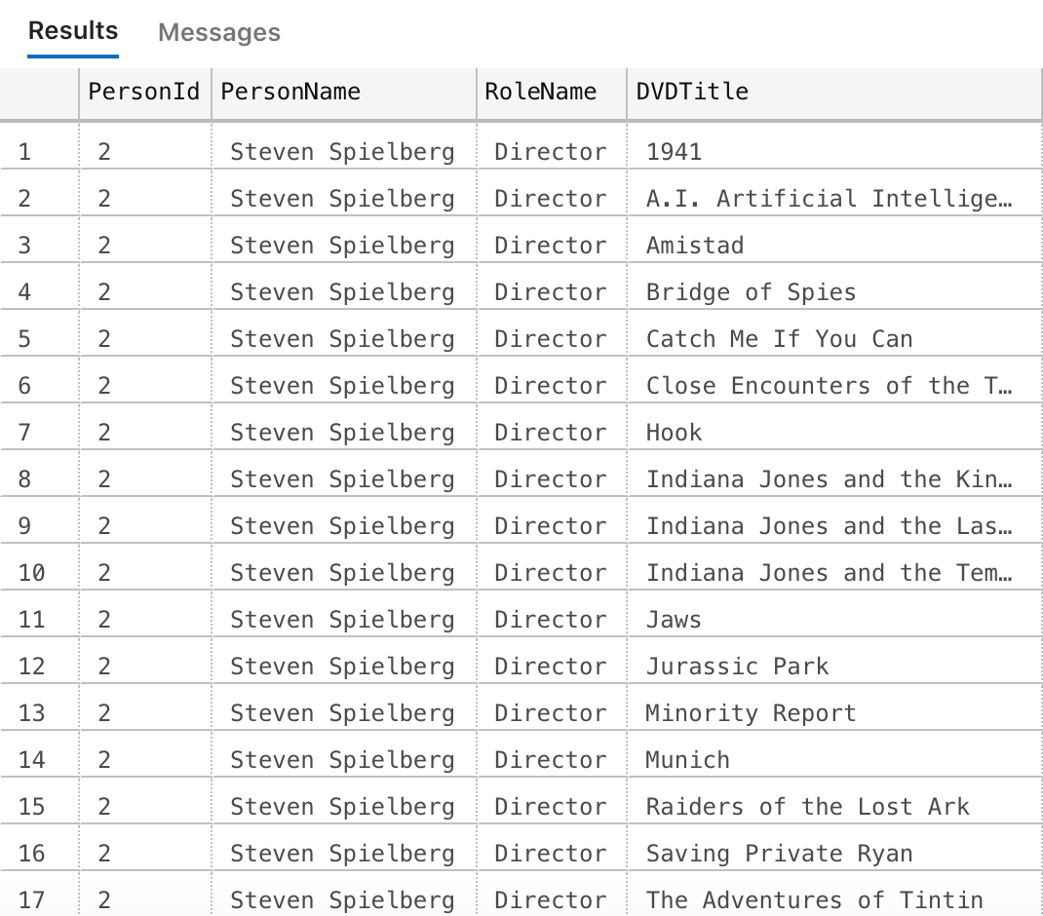
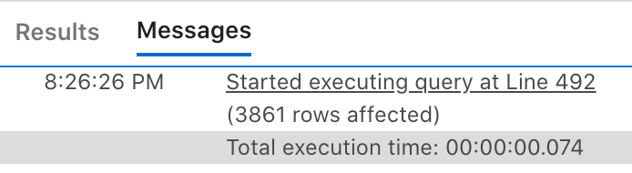
Nodes and Relations
Step1: SQL – Query all the directors
and the movies they directed
Exported as
JSON format

Slide 10
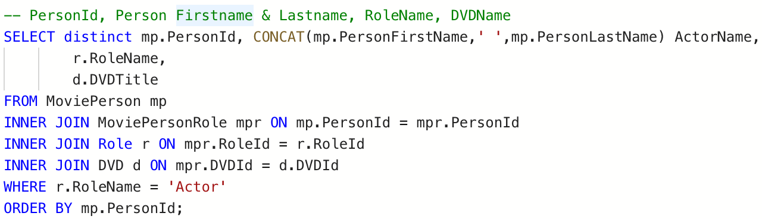
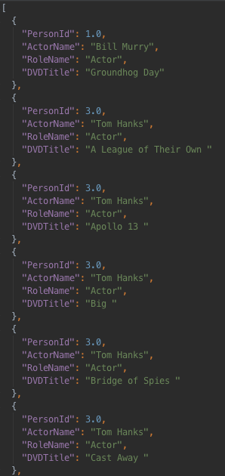
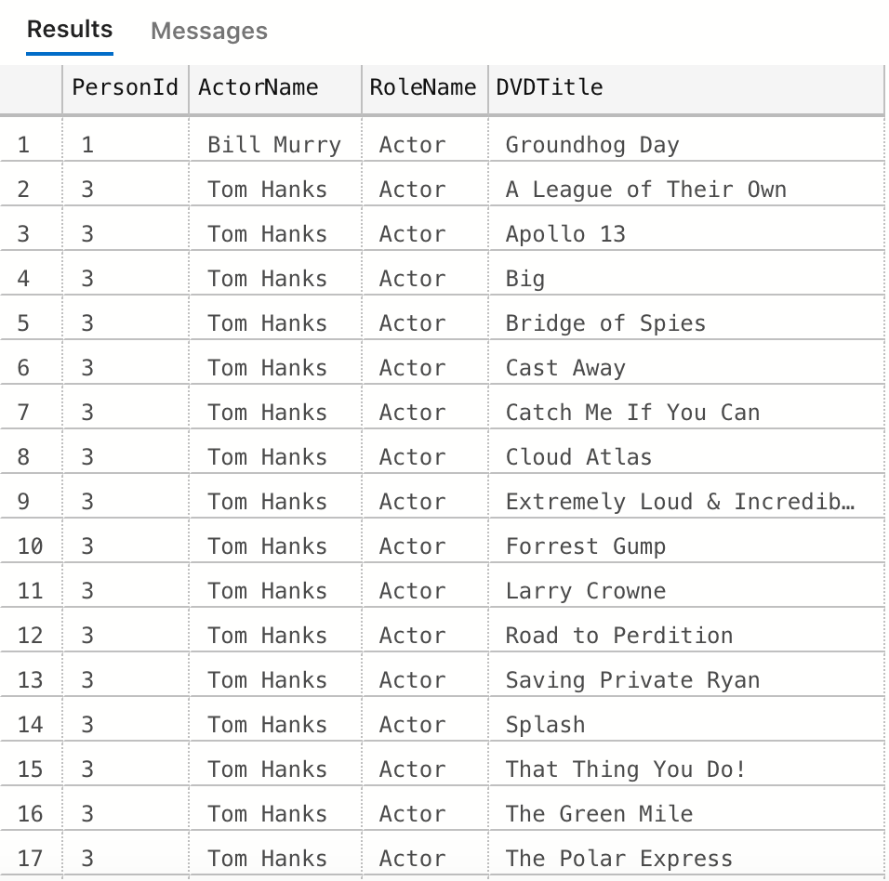

Nodes and Relations
Step2: SQL – Query all the actors
and the movies they acted in
Exported as
JSON format

Slide 11
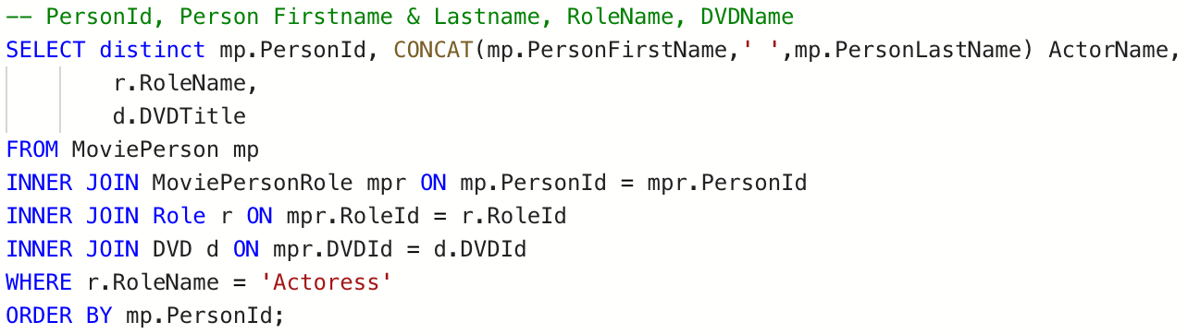
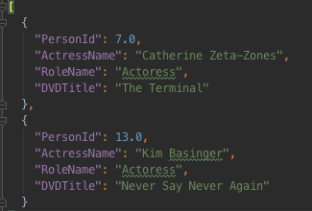
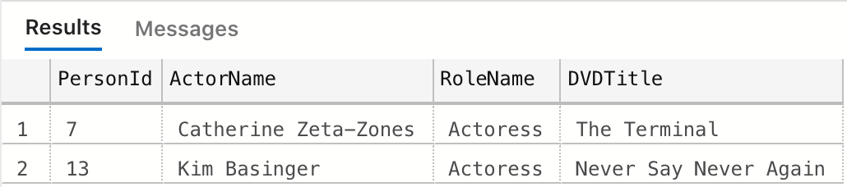
Nodes and Relations
Step3: SQL – Query all the actresses
and the movies they acted in

Slide 12
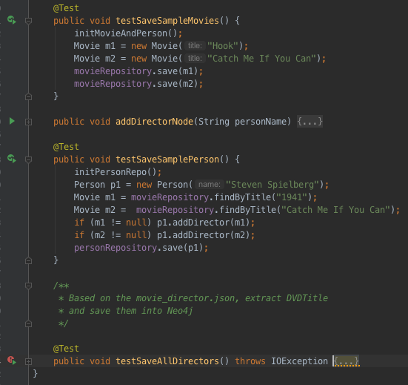
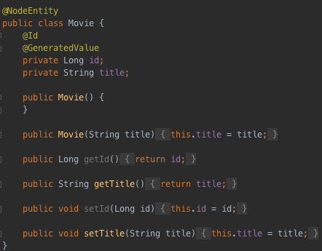
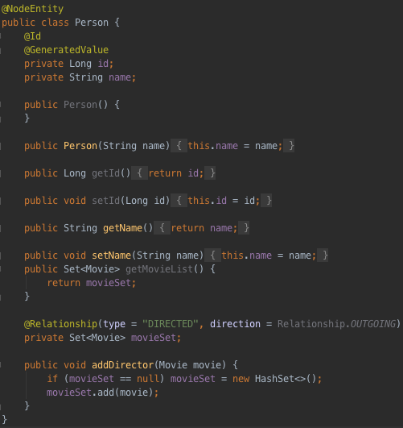
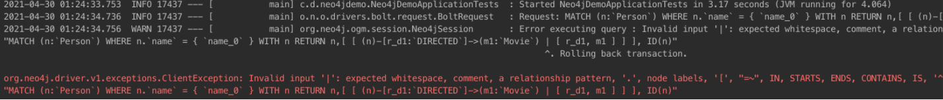
Java Integration
Entity Classes
Approach 1 (Failed many times, due to the Maven dependency version and configuration): I use Spring Boot to run application, implement web services as MVC framework, design the “NodeEntity” of Person and Movie as shown on the right side, and implement CRUD methods, such as create unique Person and Movie, add the nodes into Spring Neo4j repository, every time before I decided to create new relationships between “NodeEntity”, I will query the repository if these nodes exist; update the properties of Person’s name and Movie’s title, etc.. However, there is always an error when executing query when I run the for loop through JSON. Then I try another way.
Test Methods
Errors…

Slide 13
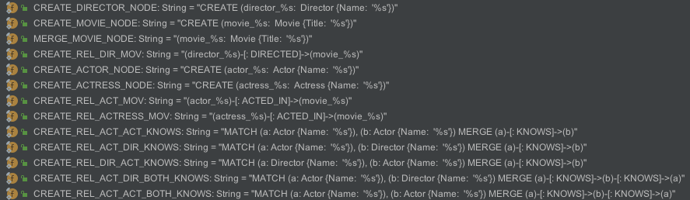
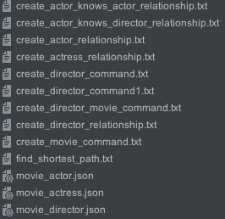
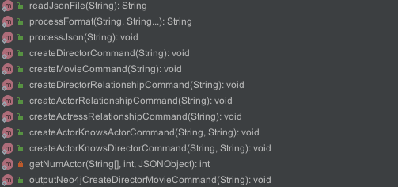
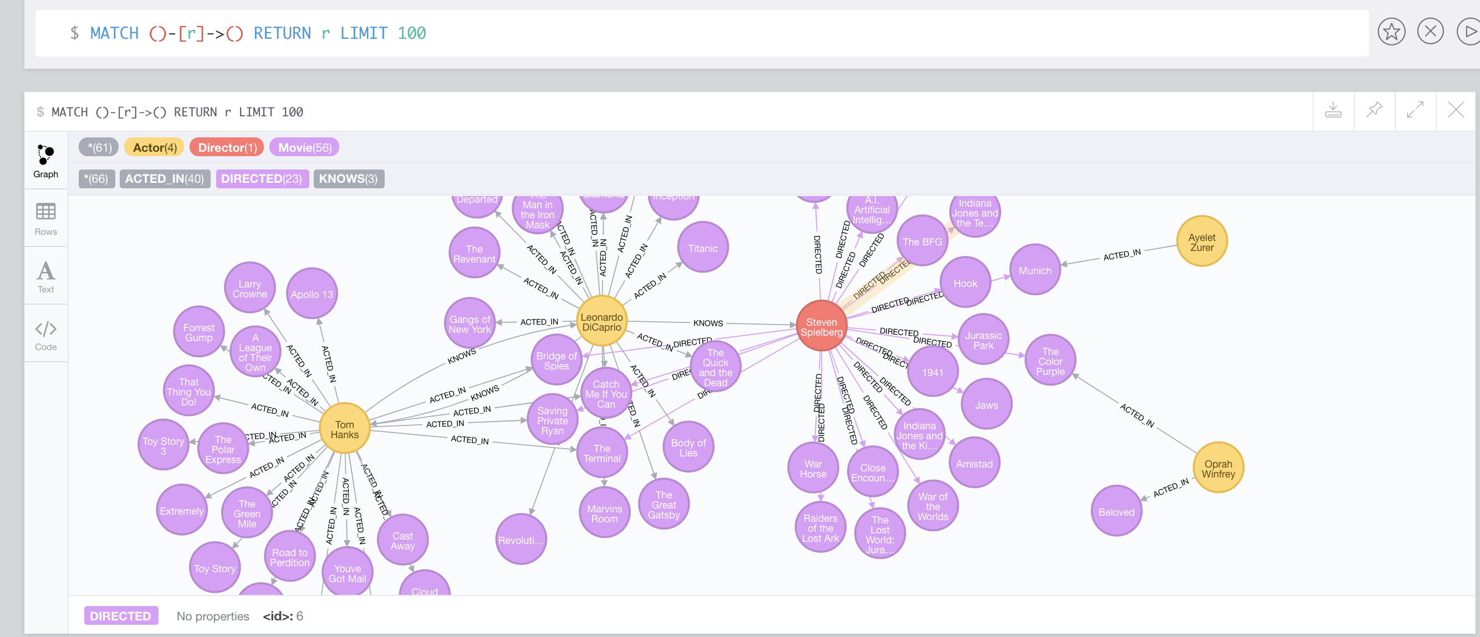
Java Integration
Approach 2 (Manually CRUD implementation, more detail through codes): Cypher is totally different. Since manually typing CQL in Neo4j is quite inefficient and repetitive, and for most of time it’s impossible for us to type multiple lines of CQL and check if the grammar is correct. More importantly, the Cypher does not allow re-used variables for creating nodes and relationships.
Thus, the ultimate goal is looking for an efficient way to generate Cypher Query Language once we just give simple instructions/inputs, after running the Java code, I used the HashMap (common key-value data structure) to store every pair of person’s name and all their related movies as list (used HashSet to store movie list, guaranteed the uniqueness), for each <key, value> pair in HashMap, I used String formatting and concatenating to build the corresponding CQL commands and streamed different types of commands to files. Finally, we can paste the commands into Neo4j to execute.
Here is my design:
Template Strings
JsonUtil, QueryUtil, UpdateUtil, DeleteUtil
Execute commands!
Start
Methods to generate different commands
MainTest

Slide 14
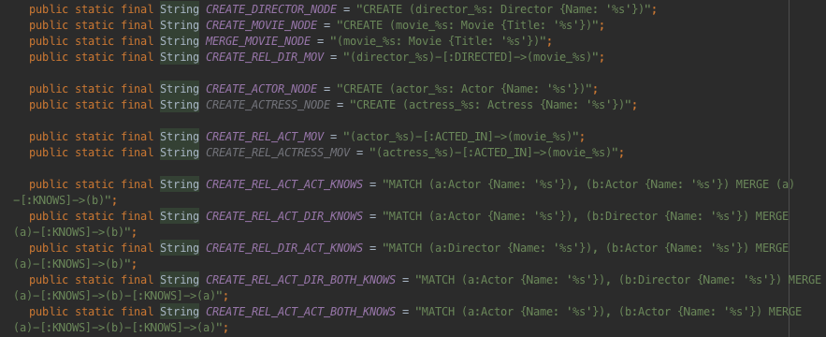
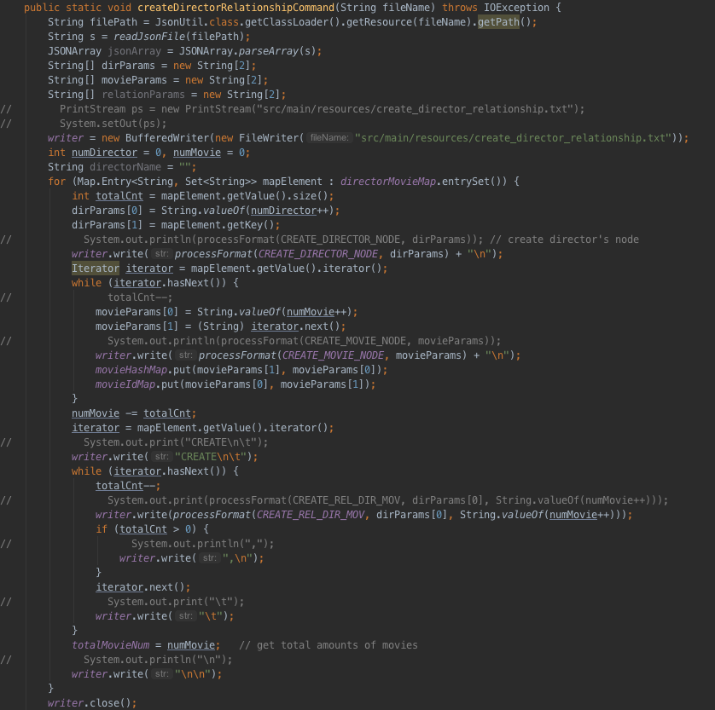
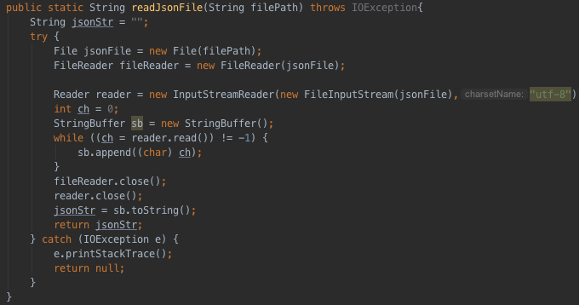
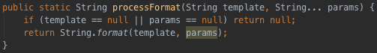
Code Implementation
1. Template Strings
2. Read JSON file
4. Create Director & Movie & Actor & Actress Relationship Commands (Take director_relationship for example.)
3. Process Format

Slide 15
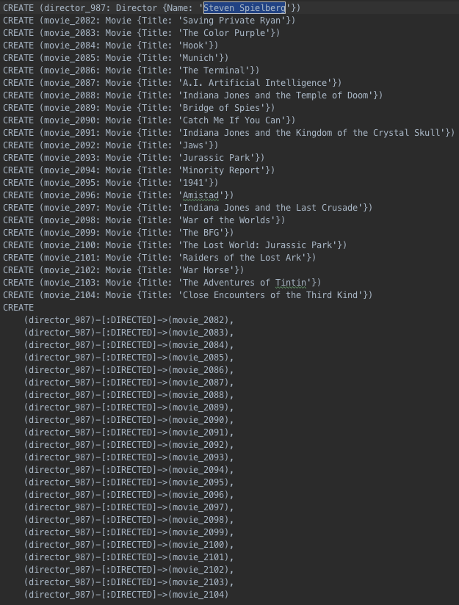
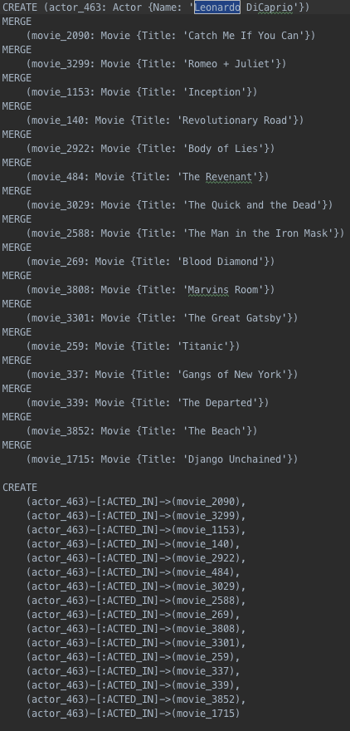
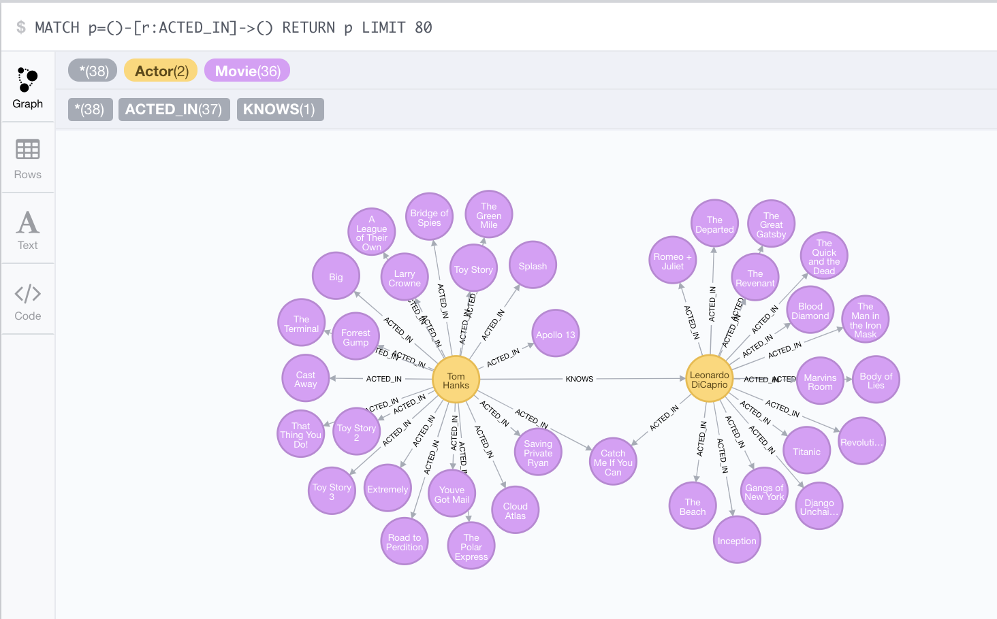
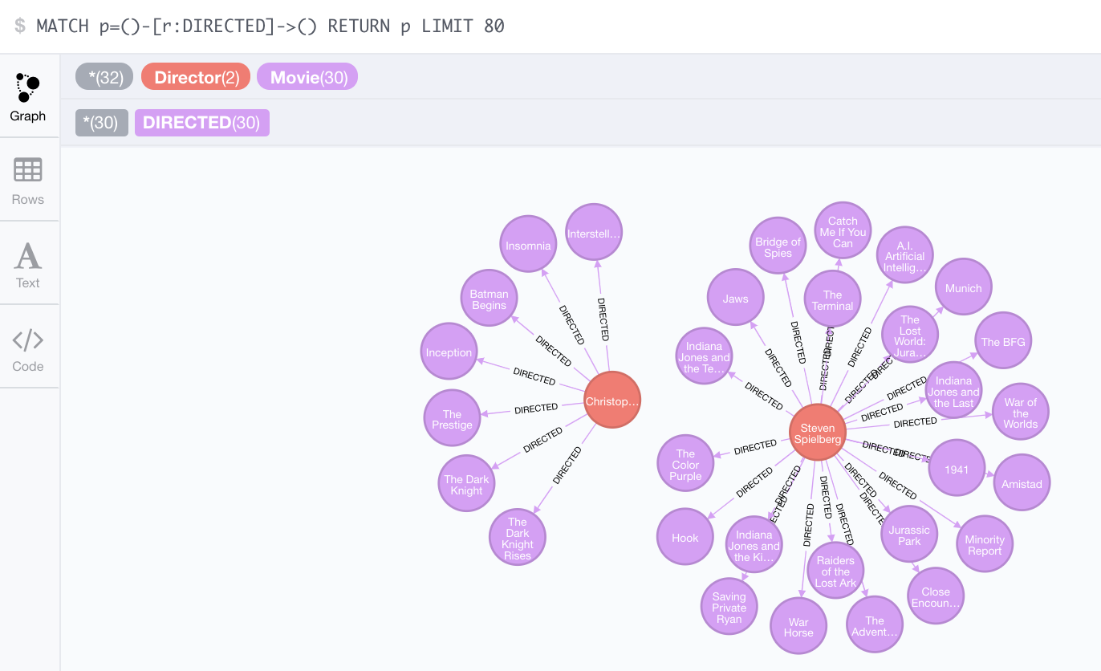
Code Implementation - Commands
create_actor_knows_actor_relationship.txt
create_director_relationship.txt
create_actor_relationship.txt
Result (Leonardo & Tom Hanks)
Result (Steven Spielberg & Christopher Nolan )

Slide 16
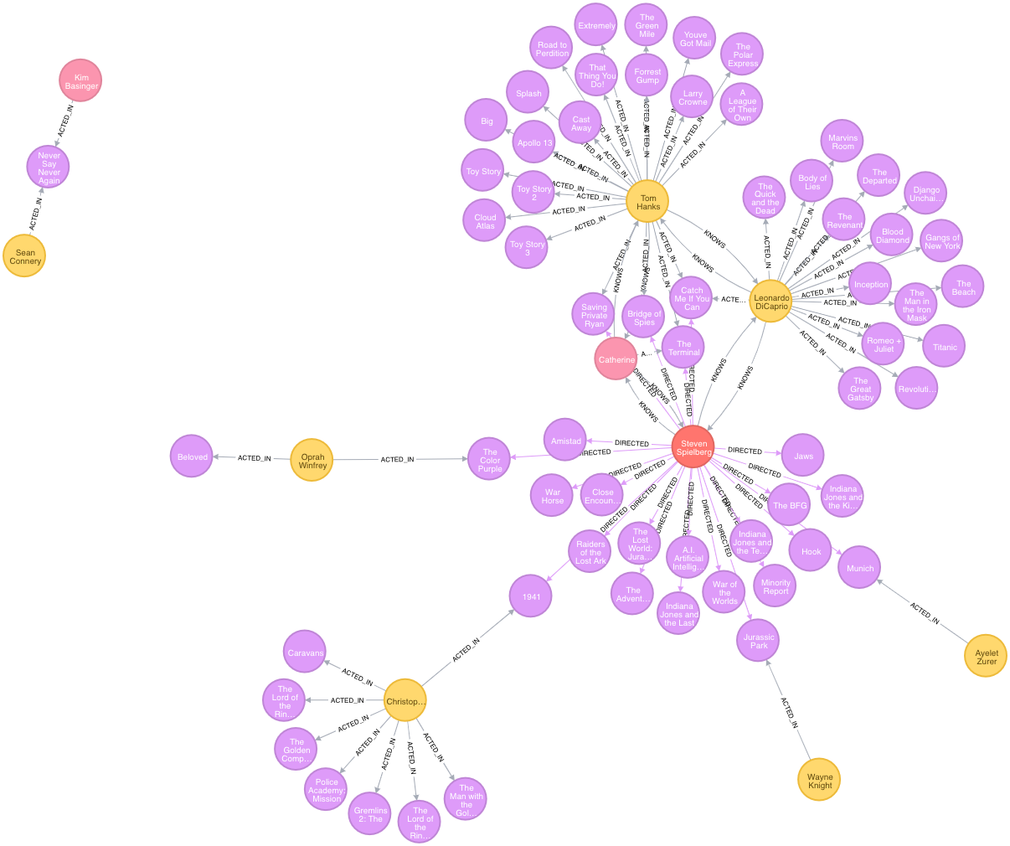
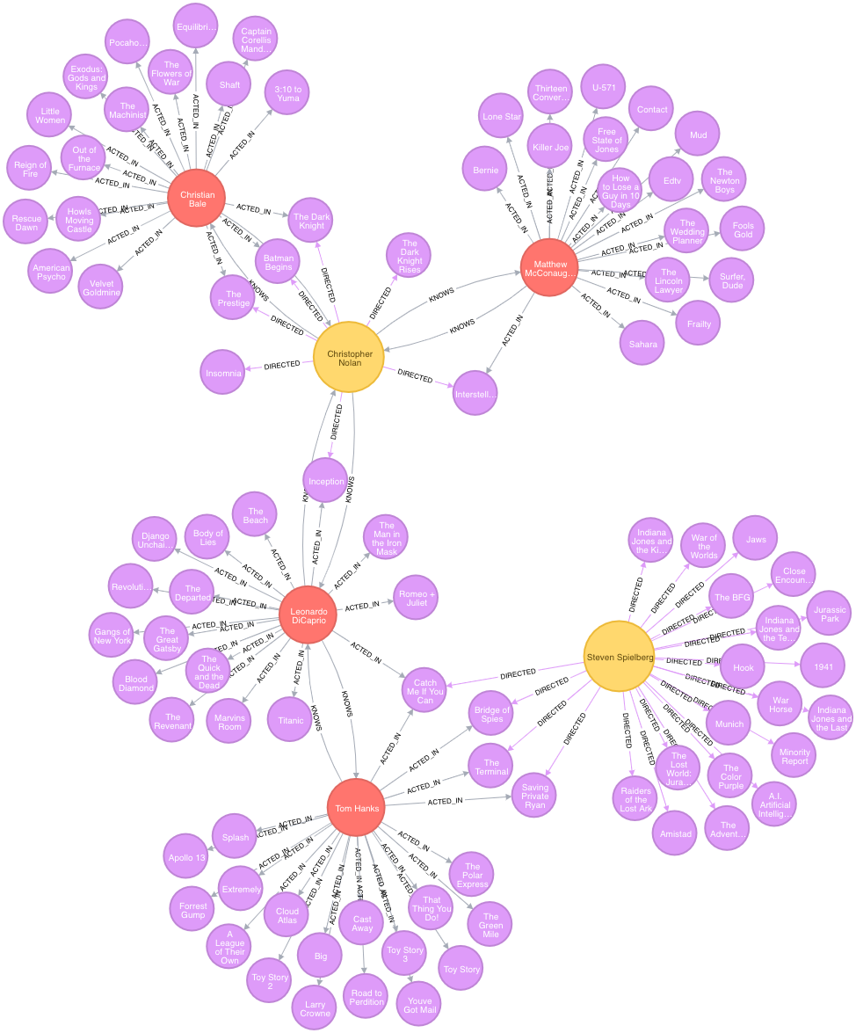
Results Display

Slide 17
Results Display
Let me show the demo through Java and Neo4j.

Slide 18
Future Works
Implement more functionalities such as recommendation system, integrating Front-end UI and running as Chatbot to receive human instructions instead of reading words in Java console.
Due to the Neo4j internal heap size limit, it cannot store all the nodes and relationships from my CREATE commands, and it is worthwhile to explore and optimize this procedure.
Aside from KNOWS, DIRECTED, ACTED_IN, we can import customer’s rating from the IMDB or other platforms by scraping corresponding data, and build more relationships so that people can find their favorite movies or actors through shortest path that I applied.

Slide 19
Thank you!

